Slide 1

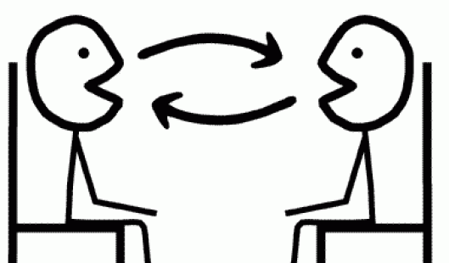
Révision!
Notes:
This lesson is about consolidating all the language learnt so far about music, likes, dislikes and reasons and bringing it together so that pupils end up being confident in have a short exchange of up to a max. of 6 questions and answers.
We are going to begin with some game activities to rehearse the language they have met, develop fluency, memory, pronunciation and confidence in speaking.

Slide 2


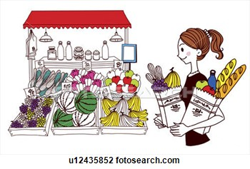
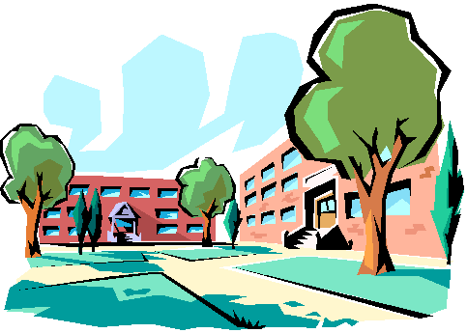

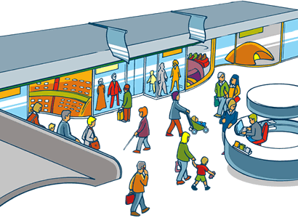
1 | 2 | 3 | 4
5 | 6 | 7 | 8
9 | 10 | 11 | 12
Notes:
Revision slide to practise this vocabulary
By now pupils could be asked to say ‘some’ or ‘a’ for each place as it applies separately for each place.
(a cinema) un cinéma
(lots of parks) beaucoup de parcs / un parc
(museums) des musées / un musée
(a castle) un château
(lots of restaurants beaucoup de restaurants / un restaurant
(a sports centre) un centre sportif
(a stadium) un stade
(a market) un marché
(a shopping centre) un centre commercial
(a university) une université
(lots of shops) beaucoup de magasins / un magasin
(a swimming pool) or (some swimming pools) une piscine / des piscines

Slide 3
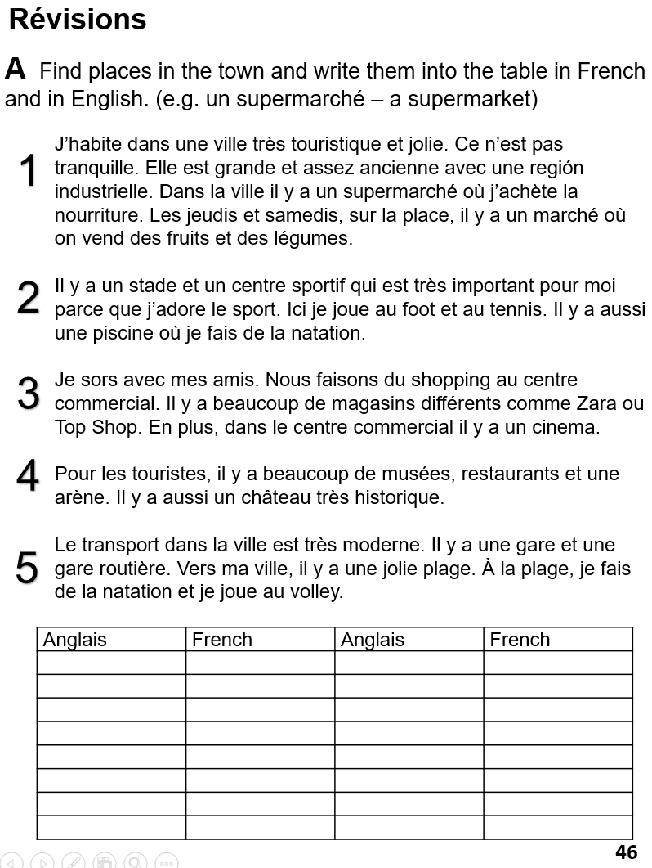

Slide 4
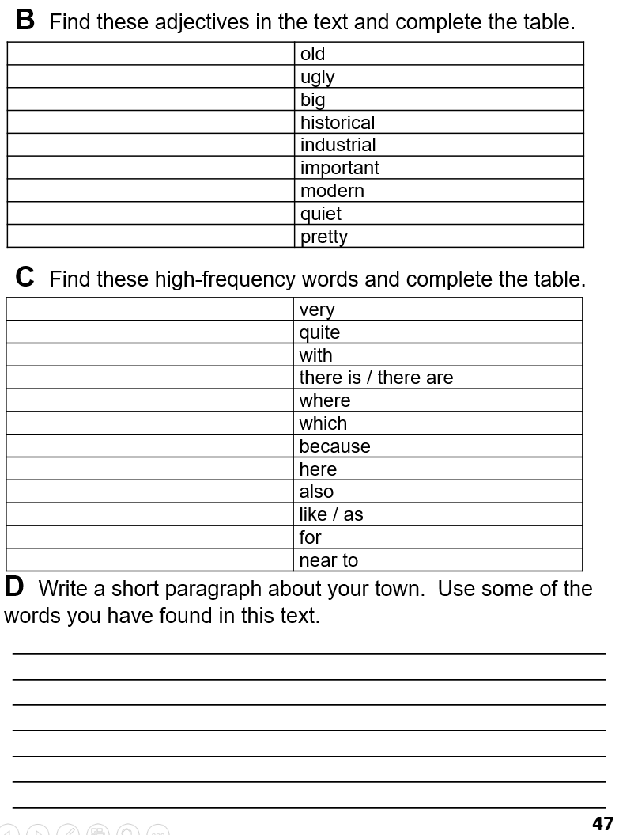

Slide 5
Comment tu t’appelles?
Quel âge as-tu?
Tu es de quelle nationalité?
Quelle est la date de ton anniversaire?
Où habites-tu?
Quelles langues parles-tu?
Comment es-tu?
Tu as des frères ou des sœurs?

